Slide 1

Department of Mechatronics Engineering
AUTOMATIC WASTE SEPARATOR FOR HOME
Project Members:
18EUMT104 – Tansin K
18EUMT105 - Tazmeel Ahamed S
18EUMT106 - Tharun Sri Ram N
18EUMT112 - Venuprasath S
Industry Guide:
Mr. Anand Bala Ganapathy, FLICKERHIVE,
Coimbatore.
Project Guide:
Ms. M. Bhuvaneswari, Assistant Professor.

Slide 2

INDUSTRY DETAILS
FLICKERHIVE
1, Subramaniapuram 1st Street, R.S.Puram,
Coimbatore – 02,
Contact- +91-9944776365
Email – flickerhive@gmail.com

Slide 3
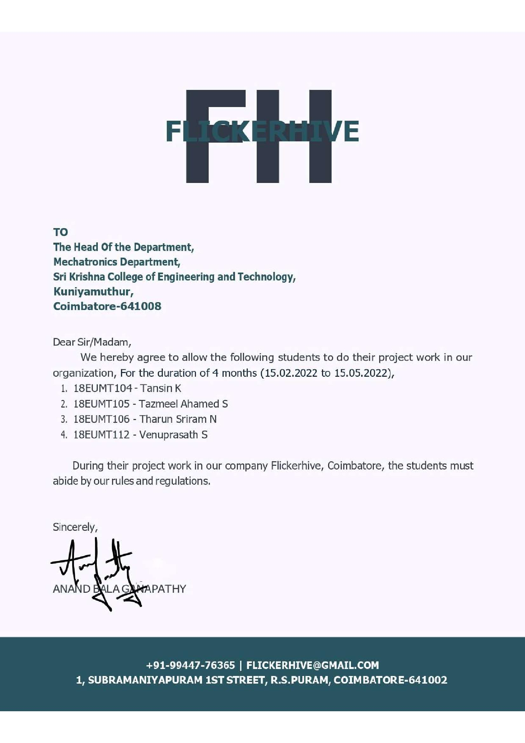
APPROVAL LETTER

Slide 4
INTRODUCTION
To design a waste separator machine which separate waste into dry, wet, and metal waste for the process of home automation.
This project aims to develop a domestic garbage separation system for household needs which can also be used in public places like schools, colleges, railway stations and airports etc.
For the current project we consider the types of waste as
Dry wastes
Wet wastes
Metal wastes

Slide 5
LITERATURE REVIEW
S.NO | Paper Title | Authors | Journal Name, Year of Publication | Inference
1 | Automatic Waste Segregation System | Venkatesh Naik | May 2020 | It focuses on how the waste segregated separately by using particularly respective sensors.
2 | Automatic Waste Sorter Machine using Proximity Sensor | Vivi Tri Widyaningr um | Oct 2020 | The aim is to automate waste sorting by applying techniques to recognize the type of waste.
3 | Waste Segregation Using Smart Dustbin | SHADAKSH ARI R | Jan 2021 | It proposes an automated waste classification system. It is used to classify objects into dry, wet and metal wastes, based on the object recognition accuracy in real-time. It is suitable for a large amount of waste segregation process.

Slide 6
LITERATURE REVIEW
S.NO | Paper Title | Authors | Journal Name, Year Of Publication | Inference
4 | Smart garbage management system | Parth Jajoo | June 2020 | It focuses on the LCD integration required for this process.
5 | IOT based automated waste segregator for efficient recycling | T.Saminatha n | Oct 2019 | The aim is to automate waste sorting by Using proximity sensor.
6 | Automatic waste management and segregation system using IOT | Nandhini.S | Feb 2021 | It proposes a software system and sensor integration for this process.

Slide 7
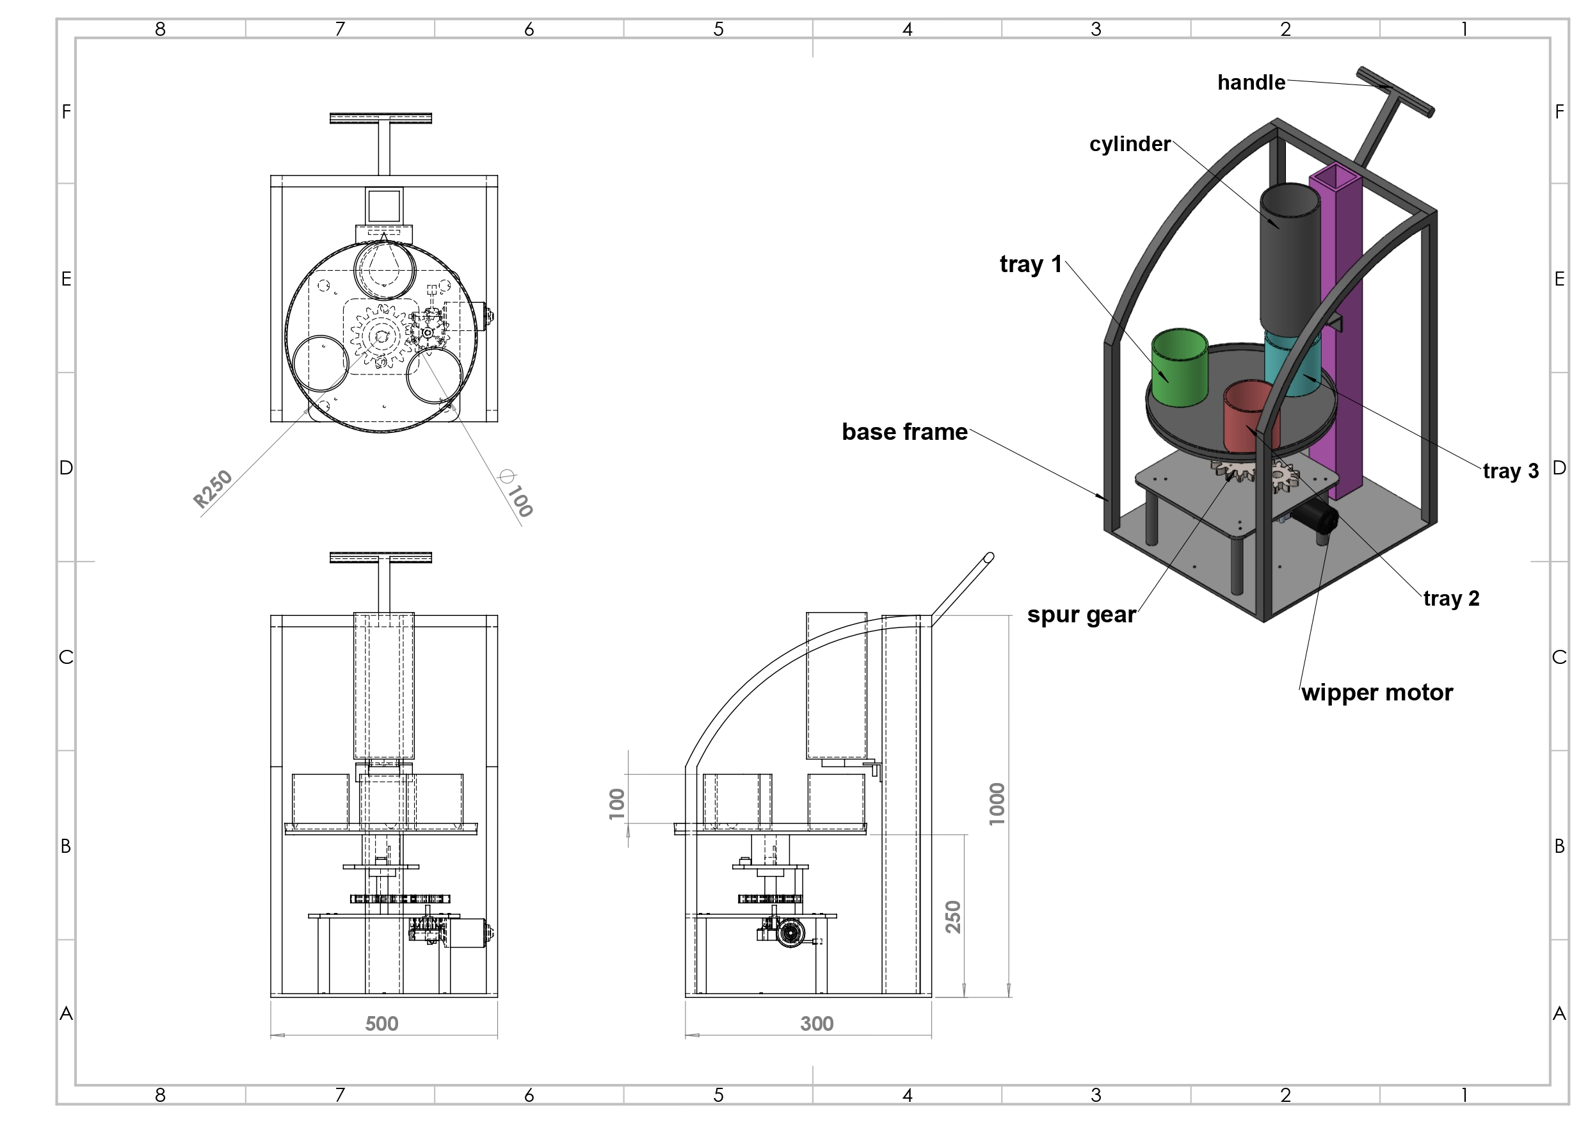
2D DIAGRAM

Slide 8
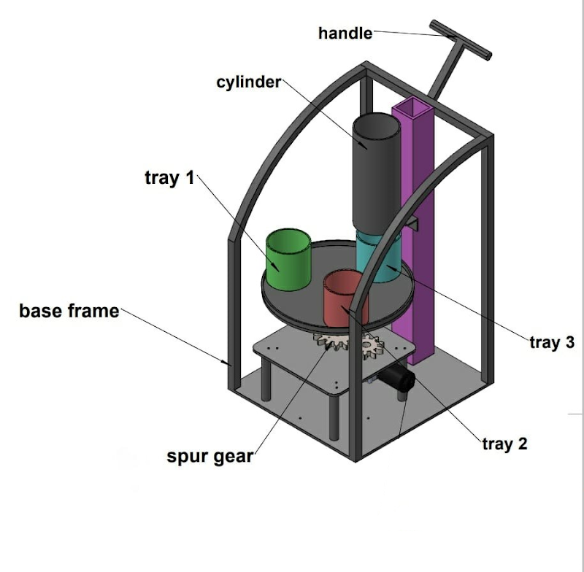
3D DIAGRAM

Slide 9
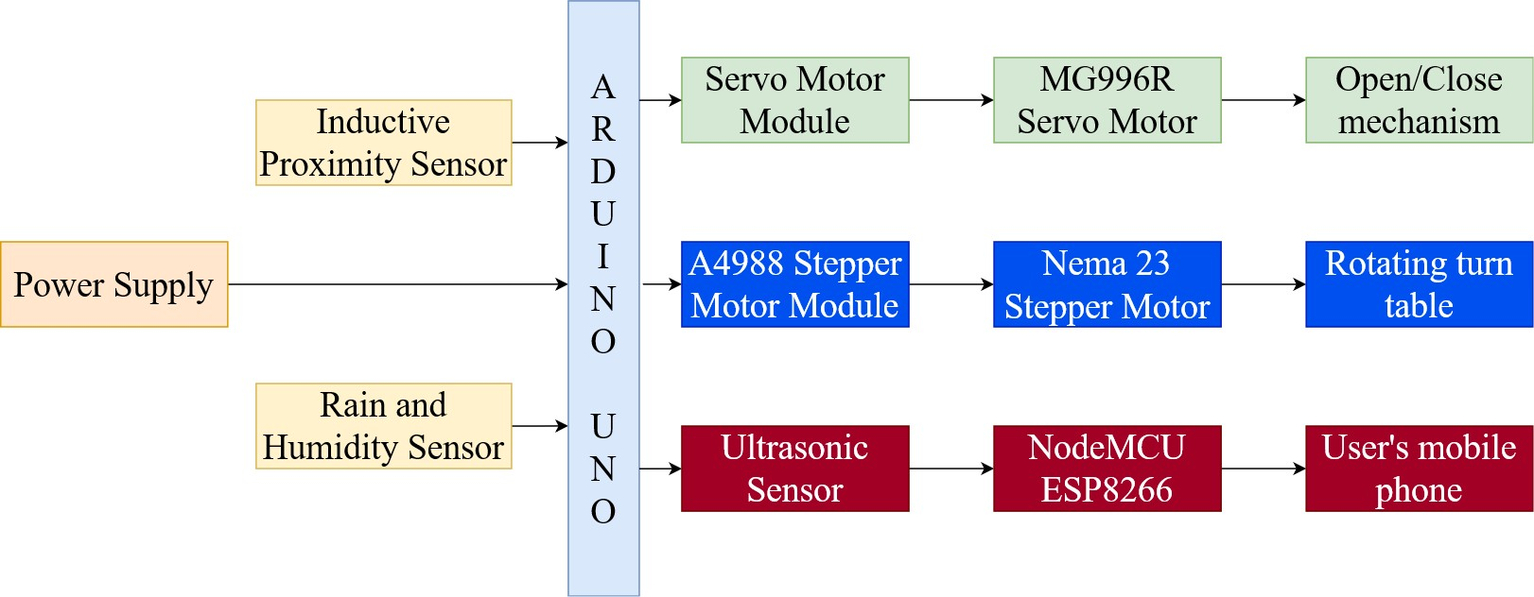
BLOCK DIAGRAM

Slide 10
CALCULATIONS
Selection of Servo Motor:
Length of the arc of sector formula = θ/360° . 2πr, where θ=120° r=50mm
By substituting the known values, we get, L.A of sector = 104.67mm
For per rotation, L.A. of sector = 104.67/120 = 0.87mm
By neutralizing it with market values, we use 1mm pitch.
B_{eff} = 0.92 (Mechanical efficiency of a motor)
Μ = 0.1 (Coefficient of friction)
F = 0 N (External force excluded)

Slide 11
CALCULATIONS
Calculation of Torque for servo motor:
T_{f} = B_{p}/2pi Beff (μgW + F)
m = 1kg ; W = m x g = 1 x 9.81 = 9.81 N
By substituting the known values, we get Tf = 0.017 kg-cm
For our application, we require a torque of 0.017 kg-cm. By referring to the servo motor catalogue, MG90 Tower Pro servo motor is selected for this application.

Slide 12
CALCULATIONS
Stepper Motor Calculations:
Diameter of index table, D_{T} = 400mm
Index table thickness, L_{T} = 100mm
Diameter of load, D_{W} = 150mm
Thickness of load, L_{W} = 150mm
Material of table and load = Iron = 7.9 x 10³ kg/m³
Number of load = 3
Distance from center of index table to center of load, C = 150mm
Positioning angle, = 120°
Resolution, = 0.04°

Slide 13
CALCULATIONS
Positioning period, t₀ = 0.4s
Required resolution, s = 0.04° = 0.02° x 2 (pulses)
The RK series PN geared type (gear ratio 1:36, 0..02°/step) can be used.
Acceleration & Deceleration period t₁ = 0.4 x 0.25 = 0.1s
A = 3 = 30°/0.02 = 1500
Operating Pulse speed f₂ = (A - f1 . t1)/(t0 - t1) = (1500-0)/(0.4-0.1) = 5000Hz
Standard stepping angle for unipolar inertia of table, J_{t} = (π/32) ρ . L. D_{t}⁴
By substituting the known values, we get J_{T} = 1.57 x 10²¹ kg.mm²
J_{w}= (π/32) . ρ. Lw. D w⁴

Slide 14
CALCULATIONS
By substituting the known values, we get J_{w} = 5.88 x 10¹³ kg.mm²
J_{w}’’ = J_{w}’ x mc²
By substituting the known values, we get J_{w}’’ = 5.88 x 10¹³ kg.mm²
J_{w} = 4 x 5.88x10¹³ = 23520 kg.mm²
Total Inertia, J_{L} = 23520 + 1.57x10⁴ = 0.3922 kg.m²
Acceleration Torque T_{a} = (J_{o} . i² + J_{L}) x (π. θs)/180° . (f2 -f1)/t1
By substituting known values, T_{a} = 22.619 x10³ J₀ + 1.92 N-m
Total required torque = (T_{L} + T_{a}) x 2

Slide 15
CALCULATIONS
By substituting known values, T_{m}= 4 Nm
So for the application, the necessary torque is 4 Nm. By looking at the stepper motor catalogue, Oriental Motors RK564BC-N36 is selected for this application.
Column calculation:
Breadth of column, b = 80mm
Length of column, l = ?
By Golden ratio, lb =1.67, l = 1.67 x 80 = 134mm. We take 700mm as length
σ= σ_{a} + σ_{b}, = σy/FOS where _{y} is the yield strength of steel = 250 N/mm²
FOS = 2 (Ductile material)
Total mass = 1.25+0.25+0.25+0.25 = 2kg

Slide 16
CALCULATIONS
F = W = mg = 19.62N
A = b x t
σ_{b} = bt³/12
σ= σ_{a} + σ_{b}
125 = 19.62/80t + 80t³/12
By simplifying it, we get t ~ 3mm
For safety, we are considering 10mm thickness
Area of moment of inertia of rectangle
Ixx = bt³/12 = 6667 mm⁴
I_{yy} = b³t/12 = 426667 mm⁴
K = √(I/A) = 2.8

Slide 17
CALCULATIONS
(l/k)₁ = 250
σy/FOS = nπ²E/(l/k)²
By substituting known values, (l/k)₂ = 62.8
So, it is long column, thus has to be proceeded with Euler’s formula
Euler’s Formula
PCr = π²EI/le²
By substituting known values, PCr = 6708N
P_{actual} = 19.62N < 6708N
So, the design is safe.

Slide 18
CALCULATIONS
Bending Stress Calculation for plate:
y= d/2
W= 91.723N
l = b = 350mm, d =?
Bending stress:
M/I = σ/y
σ= σ_{y}/FOS ; σ_{y} = yield strength of steel = 420 N/mm²
FOS = 2 (Ductile material)
σ= 210 N/mm²

Slide 19
CALCULATIONS
Moment of resistance, M = W l / 4 = 8025.76 N-mm
Moment of Inertia, I = bd³/12 y= d/2
By substituting the known values, we get d = 0.82mm. We got the value of 0.82mm for the safety and allowance, the value can be rounded to 2mm to the thickness of the plate. So, the dimensions are safe.
Column calculation:
Mass of disc = 3kg = 3000g
Mass of all 3 dustbins = 750g
Mass of total waste = 600g

Slide 20
CALCULATIONS
Mass of stepper motor = 5000g
Mass of plate = 3000g
Total mass = 3000+750+600+5000+3000 = 12350g
F = W = mg = 12.35kg x 9.81
P or W = 121 N
σ= P/A
σ = σ_{y}/FOS ; σ_{y} = yield strength of steel = 250 N/mm²
FOS = 2 (Ductile material)
σ = 125 N/mm²
A = 1 mm²
Area of circle = πr²

Slide 21
CALCULATIONS
r = 0.56 (approx. 1.5mm)
As per the market standard, diameter is taken as 3mm
Area of cross section of circle = πr² = 7 mm²
Area of moment of inertia:
I_{xx} = I_{yy} = d⁴/64 = 3.97 mm⁴
I = 4 mm⁴, A = 7 mm²
K= √I/A = 0.75
l/K= 200
σy/FOS = nπ²E/(lk)²
Both ends are fixed. So, n=4
E = 2 x 10⁵ N/mm²

Slide 22
CALCULATIONS
By substituting known values,
l/K = 251
251> 200, So, it is a short column.
We get into Johnson’s Formula
Johnson’s Formula
PCr = σyt x A x [1 - (σyt)/ (4 n π² E) . (lk)² ] ; Both ends are fixed, so n =4
By substituting the known values, we get PCr_{actual} = 876N
PCr_{actual}/P = 876/121 = 7.2N
So, design is safe.

Slide 23
CALCULATIONS
Circular Disc Calculation
Mass of 3 no. of dustbin = 900g
Mass of 3 no. of waste (approx.) = 600g
Total mass = 900g + 600g = 1650g
Total mass, m = 1.65kg
F = W = m x g
F = W = 1.65 x 9.81
F = W = 15.7N

Slide 24
CALCULATIONS
y = t/2
W = 15.7 N
t = ?
Bending Stress
M/I = σ/y
σ = σ_{y} / FOS
σ_{y} = Yield strength of steel = 250 N/mm²
FOS = 2 (Ductile material)
σ = 250/2 = 125 N/mm²

Slide 25
CALCULATIONS
M = Moment of resistance for simply supported beam
M = Wl/4 = (15.7 x 400)/4 = 1570N-mm
I = Moment of inertia for rectangle = bt³/12
y = t/2
M/I = σ/y => 1570/(400t³/12) = 125/(t/2)
t² = 18840/100000
t = 0.43mm
For safety and allowance concerns, the value t = 0.43mm is rounded off to 3mm to the thickness of the plate. Hence, the design for the circular disk is safe.

Slide 26
CALCULATIONS
Circular Flap Calculation
Mass of waste (approx.) = 0.25 kg
Mass of servo motor = 0.25kg
Total mass = 0.25kg + 0.25kg
Total mass, m = 0.5kg
F = W = m x g
W = 0.5 x 9.81
W = 5N
t =?
Bending Stress
M/I = σ/y

Slide 27
CALCULATIONS
σ = σ_{y} / FOS
σ_{y} = Yield strength of steel = 250 N/mm²
FOS = 2 (Ductile material)
σ = 250/2 = 125 N/mm²
M = Moment of resistance for simply supported beam
M = Wl/4 = (5 x 100)/4 = 125 N-mm
I = Moment of inertia for rectangle = bt³/12
y = t/2
.

Slide 28
CALCULATIONS
M/I = σ/y
(125 x 12)/(100t³) = (125 x 2)/t
t² = 1500/25000
t = 0.24mm
For safety and allowance concerns, t = 0.24mm is rounded off to 2mm to the thickness of the table. Hence, the design for the circular flap is safe.

Slide 29
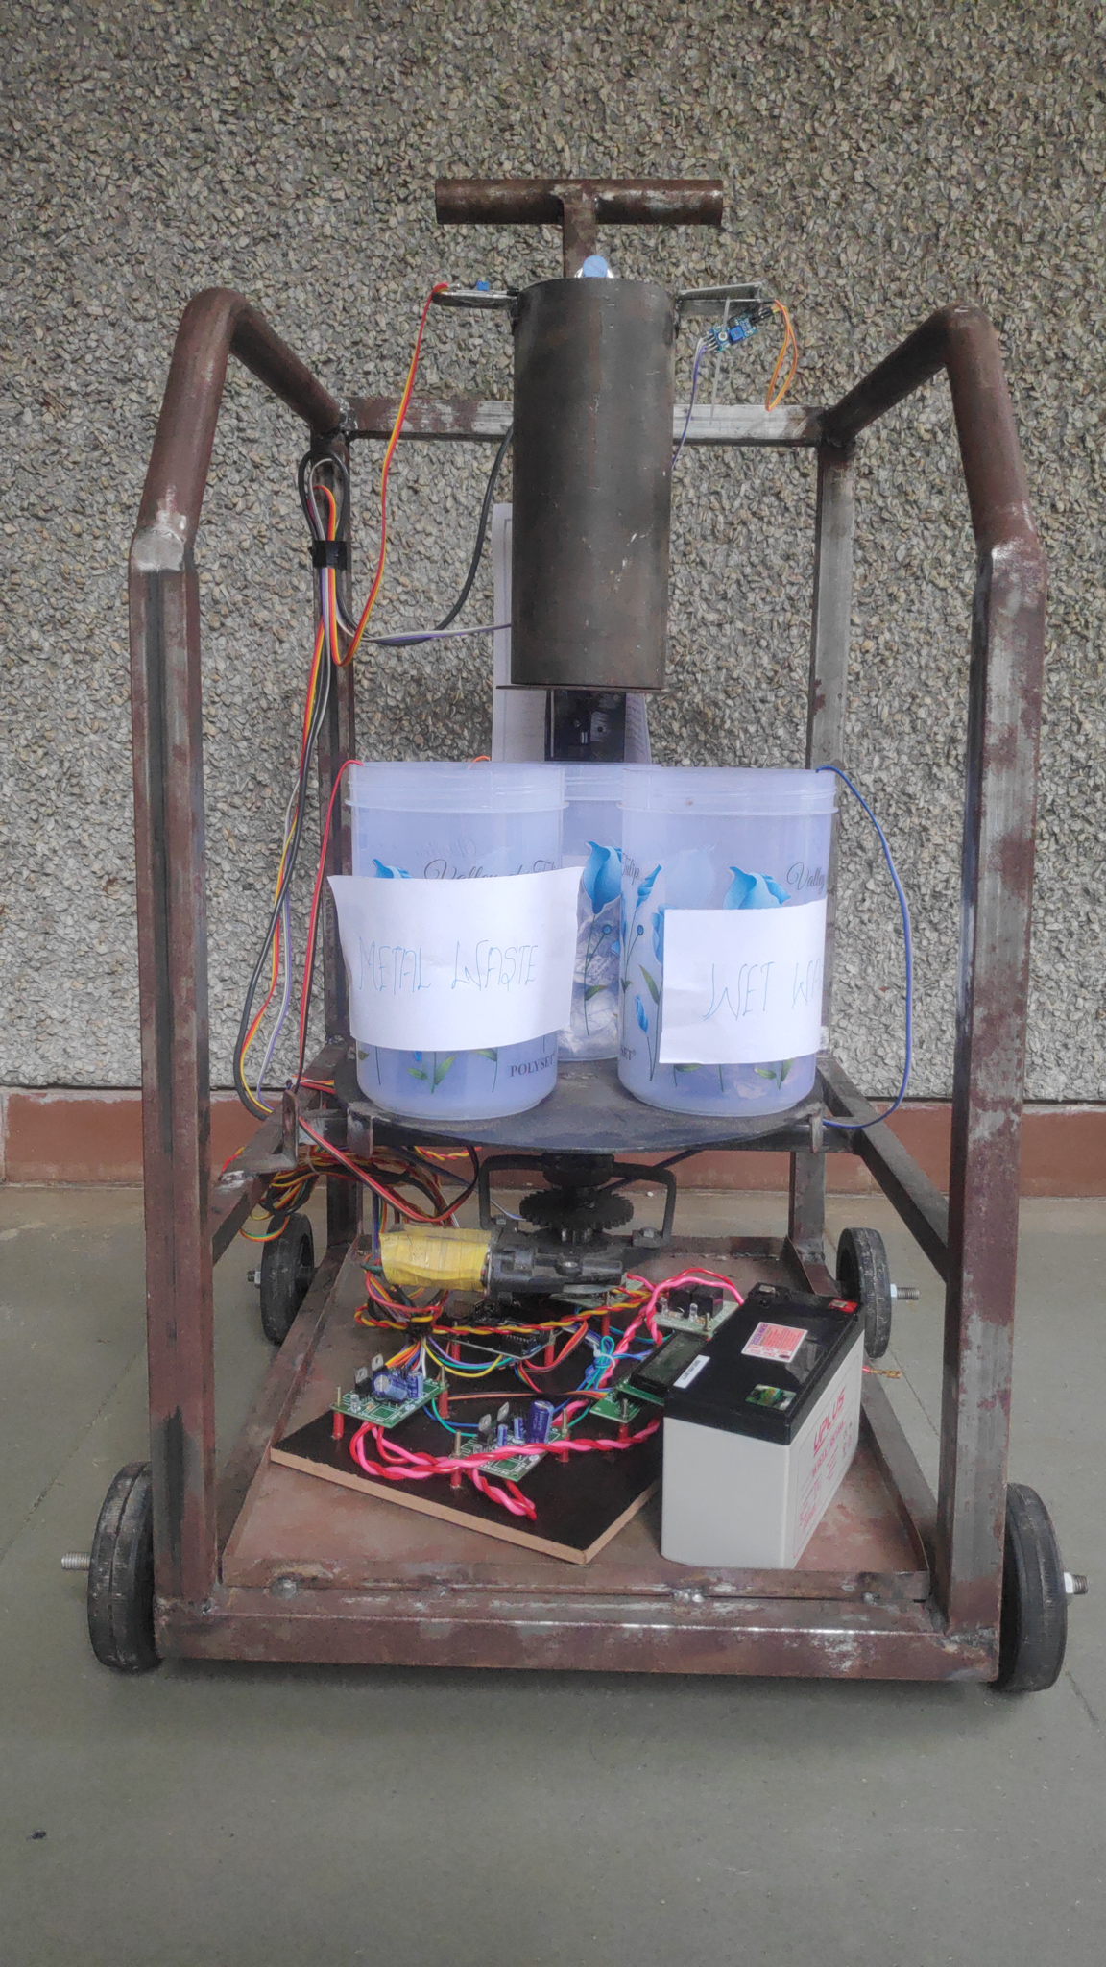
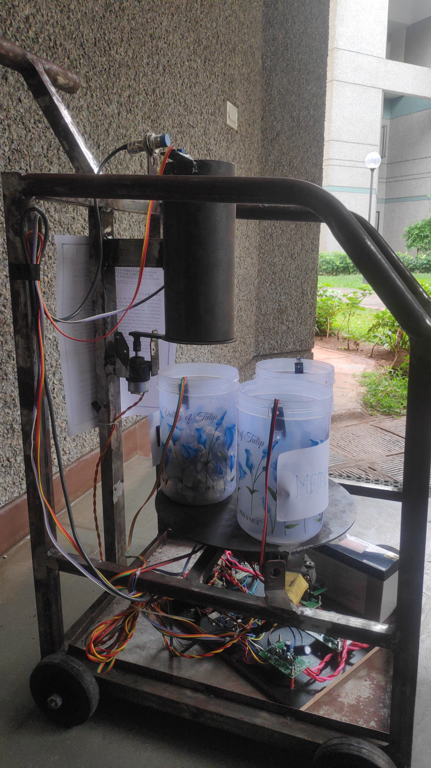
FINAL PRODUCT

Slide 30
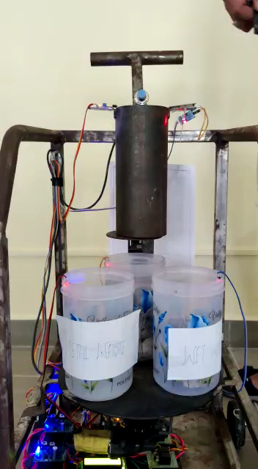
FINAL PRODUCT
Drive link: Automatic Waste Segregation Machine

Slide 31
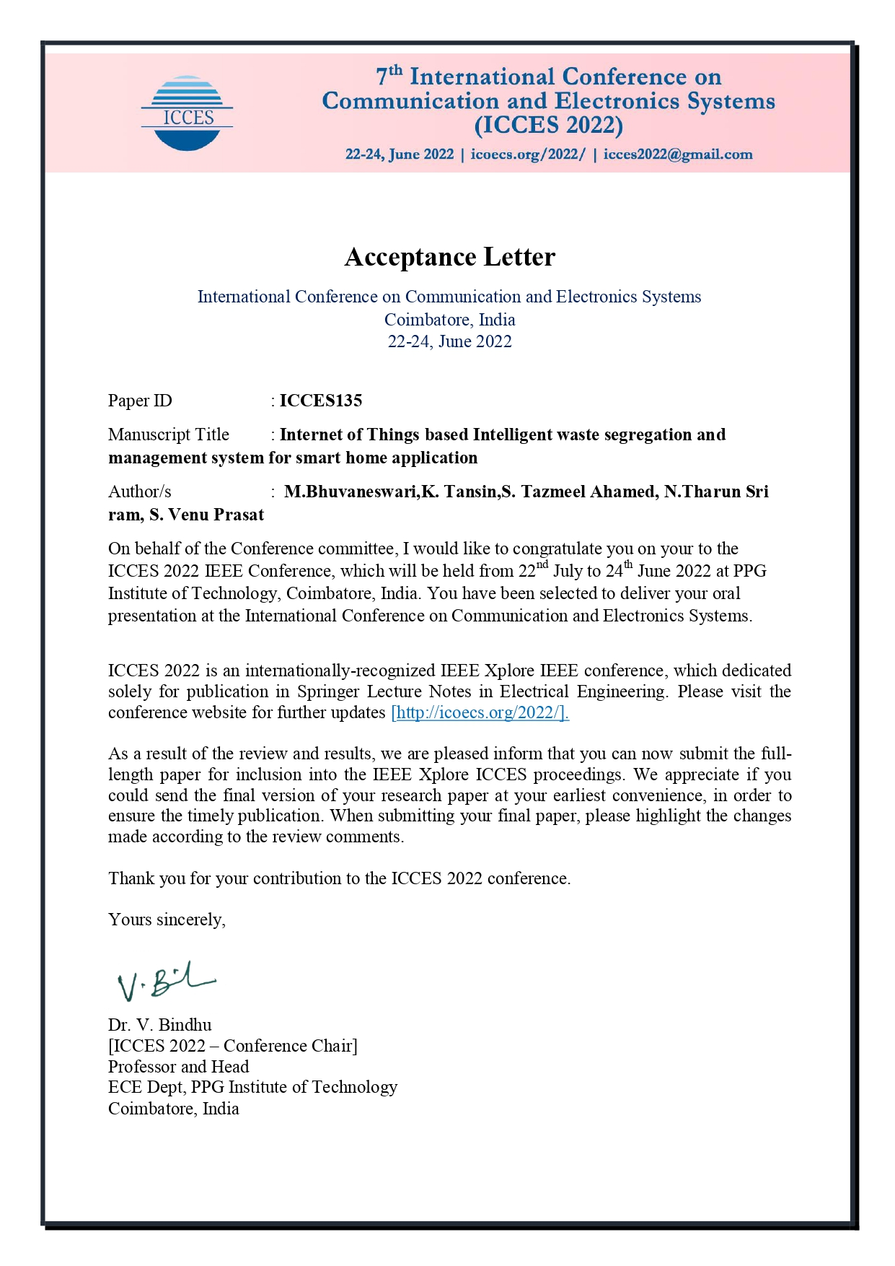
PAPER ACCEPTANCE LETTER

Slide 32
COMPONENTS OF THE MODEL
S. No. | Components Required | Specification | Units | Cost
1 | Stepper motor | Oriental Motors RK564BC-N36, 5-Phase Micro stepping motor | 1 | 5500
2 | Servo motor | Towerpro MG90 Servo Motor | 1 | 599
3 | NodeMCU | NodeMCU ESP8266 | 1 | 362
4 | Arduino UNO | ATmega328P based board | 1 | 1385
5 | Inductive Proximity Sensor | M8 Inductive Proximity sensor | 1 | 550
6 | Ultrasonic Sensor | LM393 IR Sensor | 4 | 140
7 | Temperature Humidity Sensor | Evelta SHT20 I2C Rain & Humidity Sensor | 1 | 1108
8 | Liquid Crystal Display | 16x2 Alphanumeric Display JHD162A | 1 | 230
9 | Wi-Fi Module | HC-05, RF Transceiver Module | 1 | 454
 |  |  | Total | ~₹15500 (including fabrication costs)

Slide 33
REFERENCES
[1] Namratha A M,Nandini S,Nanditha K, “Automatic Waste Management and segregation system using IoT” International Journal of Engineering and Technology (IJERT), NCCDS-2021 Conference Proceedings.
[2] Parkash, Prabu, " IoT Based Waste Management for Smart City," (An ISO 3297: 2007 Certified Organization), Vol. 4 Issue 2 February 2016.
[3] Lilyan Anthony, Pradnya Chavan, Astrid Ferreira, Prerana Gadhave, Archana Shirke, “Garbage Monitoring System for Smart Cities,” International Journal of Advanced Technology in Engineering and Science, April 2017, Vol. No.5, Issue No.04
[4] Ms. Puja k. Dhotrel , Ms. A. L. Borker “A Review on Smart Garbage Monitoring System Using Internet of Things (IOTs)” September 2017 ISBN:978-93-86171-66-5
[5] T. Saminathan, Akash Musipatla, P. Manideep Varma, P. Shahid Khan, G. Mahesh Kumar, “IOT Based Automated Waste Segregator for Efficient Recycling”, Oct 2019
[6] Chethan Siddeshwar K R, Gunasagar, C M, Hemanth S, ”Automated Waste Segregator”, Visvesvaraya Technological University, 2020-2021

Slide 34
REFERENCES
[7] Padmakshi Venkateshwara Rao, Pathan Mohammed Abdul Azeez “IoT based waste management for smart cities” International conference on computer communication and information (ICCCI), Coimbatore, India, Jan 22-24, 2020.
[8] Saminathan T, Akash Musipatla, ”IoT based Automated Waste Segregator for Efficient Recycling”, InternationalJournal of Innovative Technology and Exploring Engineering (IJITEE), Volume-8 Issue-6S,April2019.[9] Chetna Kaushal, Anshu Singla "Architecture for garbage Monitoring System using Integrated Technology"15 September 2020.
[9] Ms. Akhila Joseph, Ms. Anjali,”Smart garbage management system”,International Research Journal of Engineering and Technology (IRJET),Volume: 07 Issue: 06 | June 2020 .
[10] Vikrant Bhor, Pankaj Morajkar, Maheshwar Gurav, Dishant Pandya, Amol Deshpande, “Smart Garbage Management System” International Journal of Engineering Research & Technology (IJERT) ISSN: 2278-0181 IJERTV4IS031
[11] Mustafa M.R1 , and Ku Azir K.N.F,”Smart Bin: Internet-of-Things Garbage Monitoring System”,MATEC Web of Conferences 140, 01030 (2017)

Slide 35
THANK YOU

